Slide 1
20190218
Machine Learning를 이용한 Photonics paper research
Lee Jong Geon

Slide 2
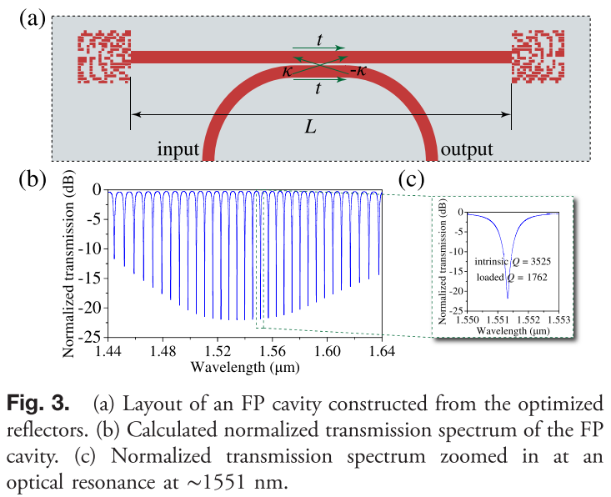
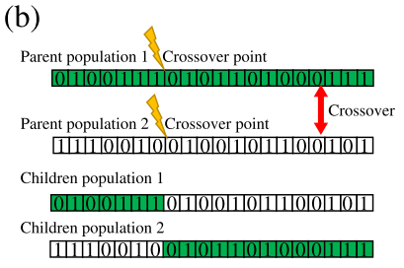
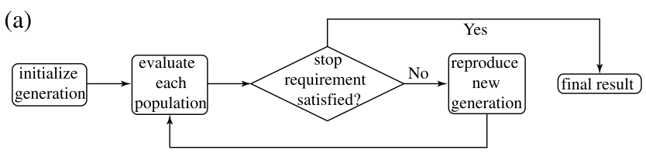
2017-PHOTONICS Research-5,6-Genetically optimized on-chip wideband ultracompact reflectors and Fabry-Perot cavities (Zejie Yu, Haoran Cui, Xiankai Sun)
18 x 18 pixel which is a square of 120nm x 120nm
Si (n = 3.49), SiO₂(n = 1.45)
Fabricate: electron-beam lithography followed by plasma etching
Genetic Algorithm
Stop requirement: fitness above 0.99 or does not increase for more than 10 generations

Slide 3
Genetic Algorithm을 이용한 simulation으로 결과 얻기

